Slide 1

Git
http://github.com/abpwrs/git-talk

Slide 2
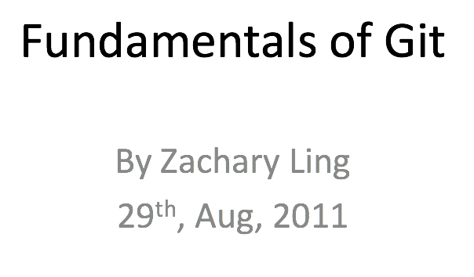
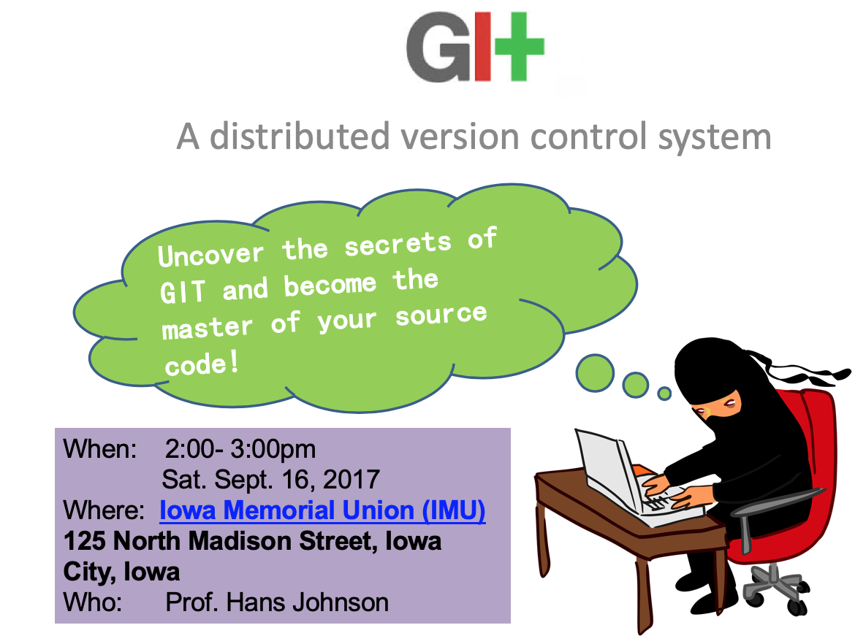
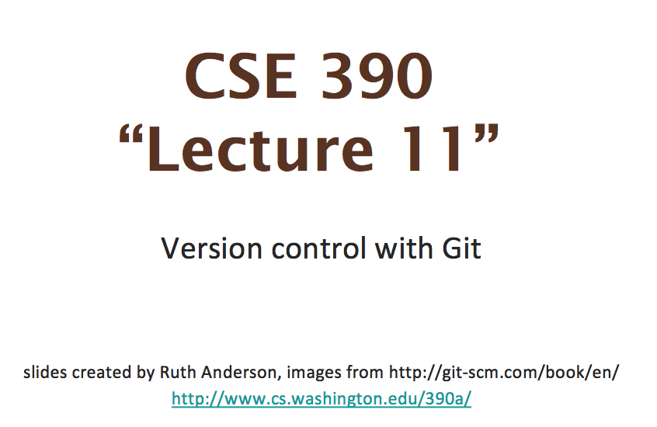
Acknowledgements
LOL, This isn’t all my intellectual property

Slide 3


Slide 4
Overview
Why Git?
Git Basics
The .gitignore
Branches
Conflict

Slide 5
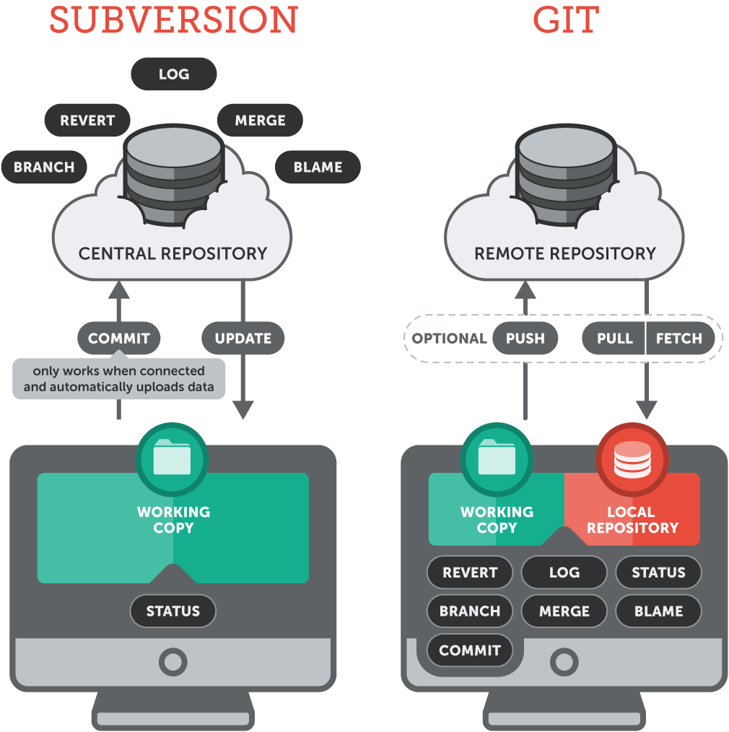
Why Git?

Slide 6
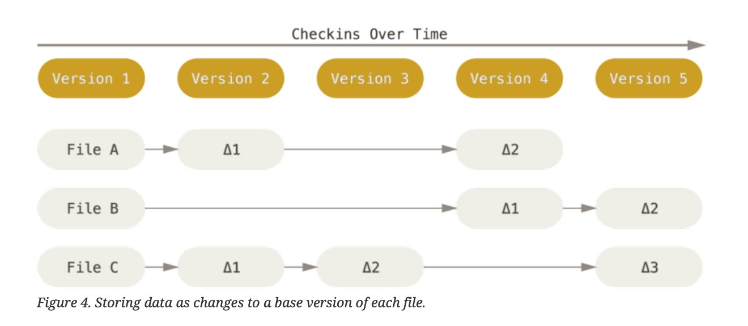
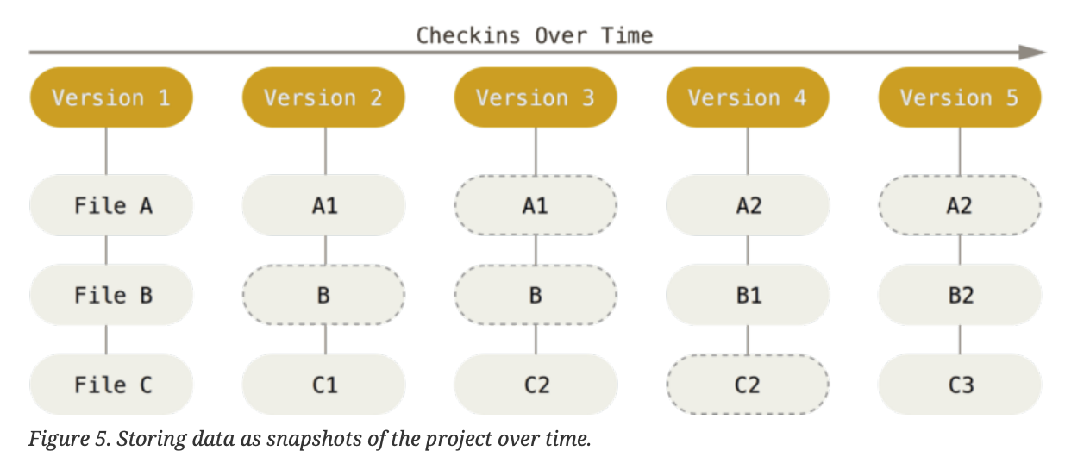
Data Storage
Git
40 Character SHA-1 hashes
Every copy has the entire repo history
SVN
Version # increments on every change
Need backups in case the server fails

Slide 7
Centralized vs Distributed
Centralized
Distributed
Server w/ database
Client w/ working copy
Serialized Workflow
Must be on a network to communicate w/ server
Central server only by convention
Backups aren’t necessary, as everyone has a complete history
Distributed Workflow
VCS features online or offline

Slide 8
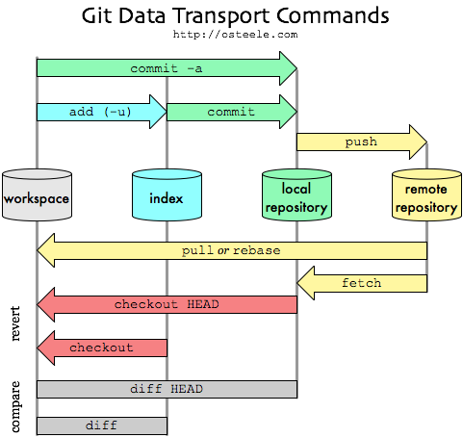
Git Basics

Slide 9
The Bare Necessities
git add
Stages files to be a part of the next commit
git commit
Commits files from staging area
(adds a commit “node” to the git history “linked list”)

Slide 10
Remote Commands
git fetch
Fetches a branch or all branches of a remote repository
git pull
Does git fetch and then merges that branch
git push
Pushes a branch and its commits to a remote repository
git remote add
Adds a remote repository

Slide 11
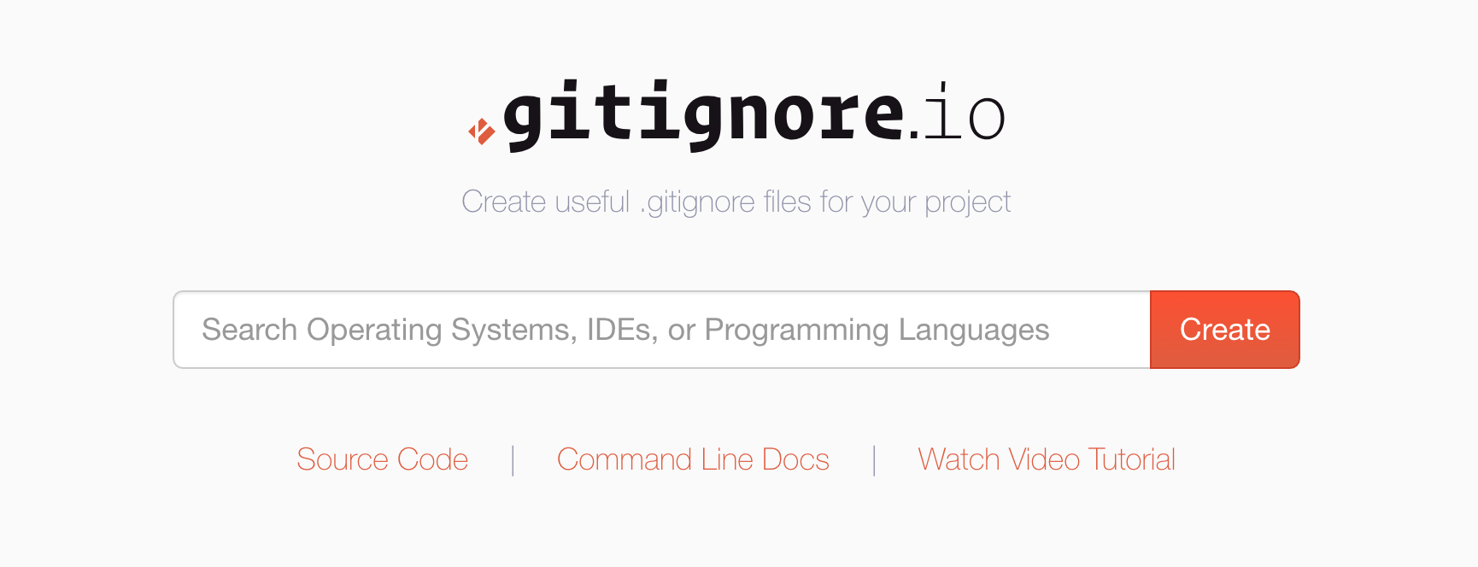
The .gitignore

Slide 12
What is a .gitignore?
A .gitignore file is a list of files, file extensions, and paths that should not be tracked by git

Slide 13
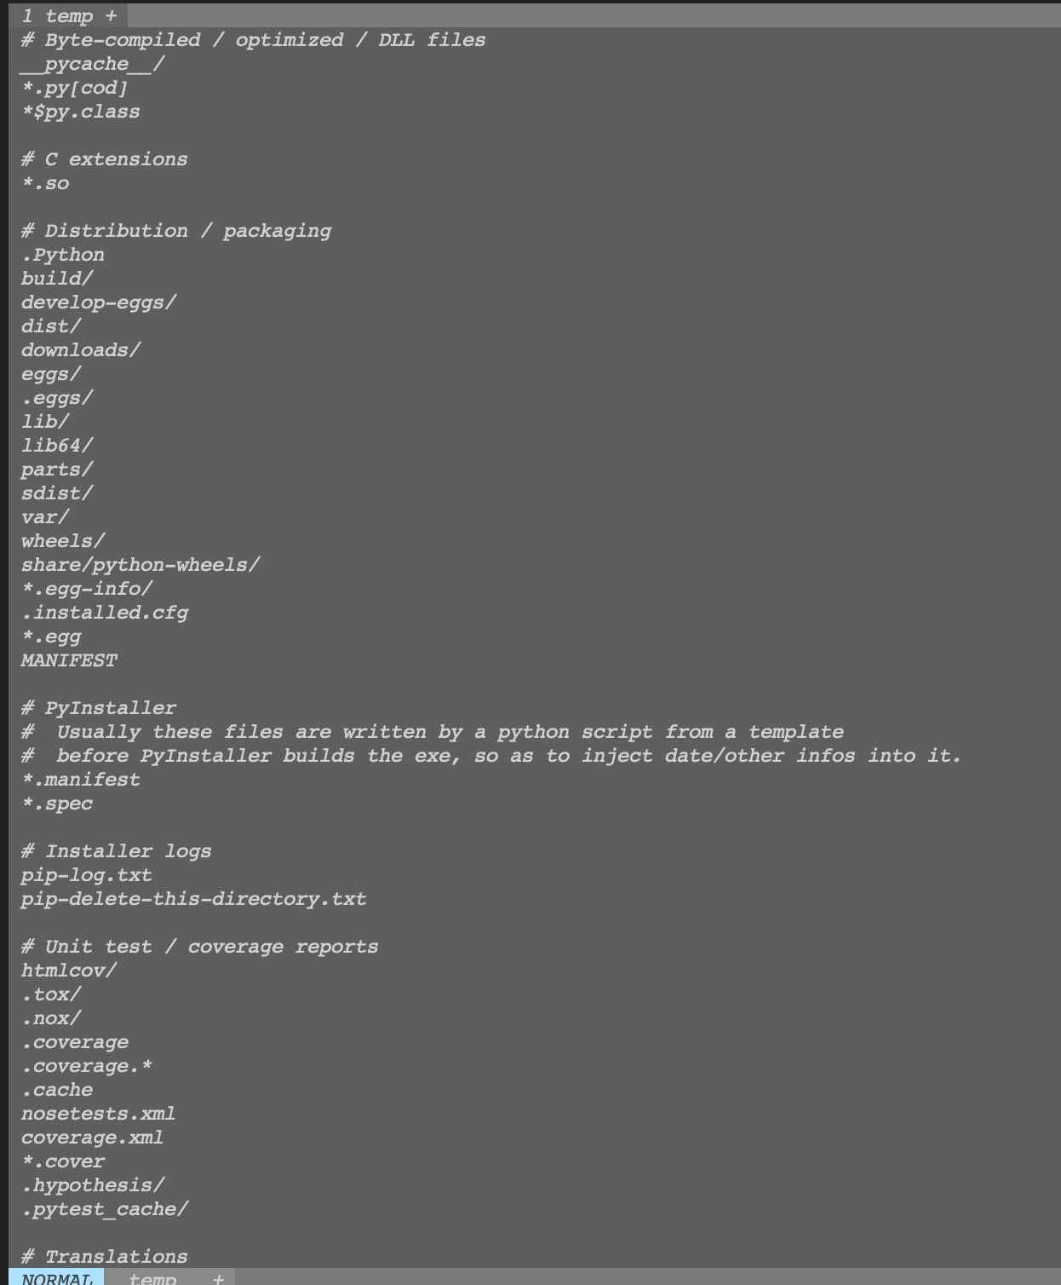

Slide 14
What do I put in a gitignore?
Most communities and languages have guidelines -- https://www.gitignore.io/
All of your personal environment configuration should be ignored:
.idea
.vscode
Certain confidential components of applications you will build
Client secrets
Databases
API keys

Slide 15
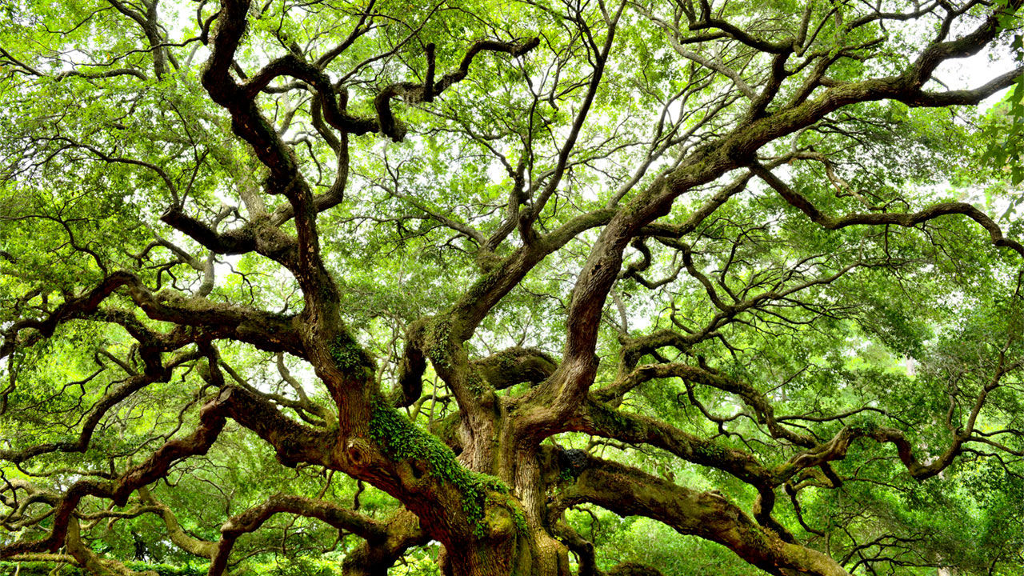
Branches

Slide 16
What is a branch?
A branch is a pointer to a commit
Your entire git history is actually a LinkedList of commits
Changing branches is simply changing your HEAD pointer
HEAD is a special pointer that points to the latest commit of the currently checked out branch

Slide 17
Git Branch Commands
git branch
No args – lists branches
<name> -- creates a new branch named <name>
git checkout <branch>
Switches which branch you are currently working on
git merge <branch>
Merges the contents of <branch> into the branch you are currently on

Slide 18
Branch Example

Slide 19
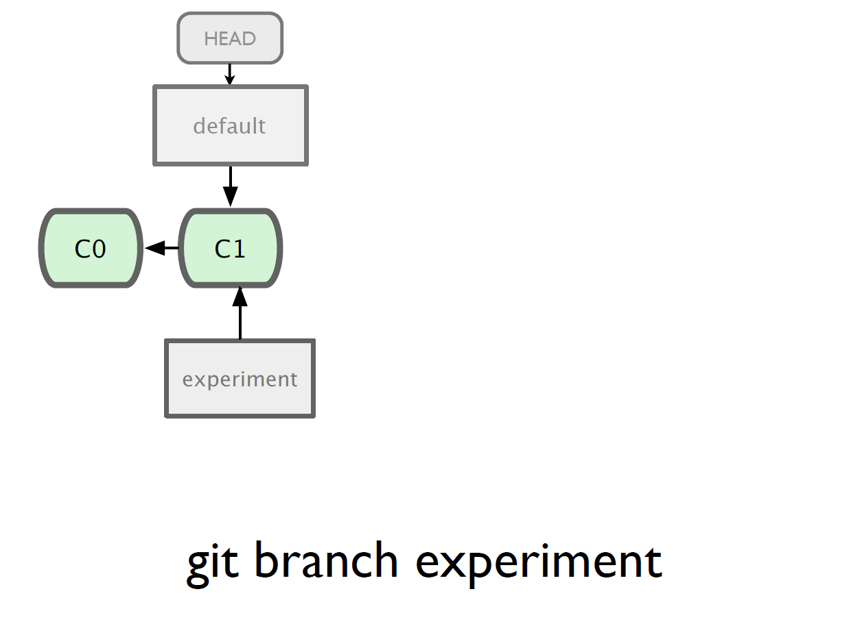

Slide 20
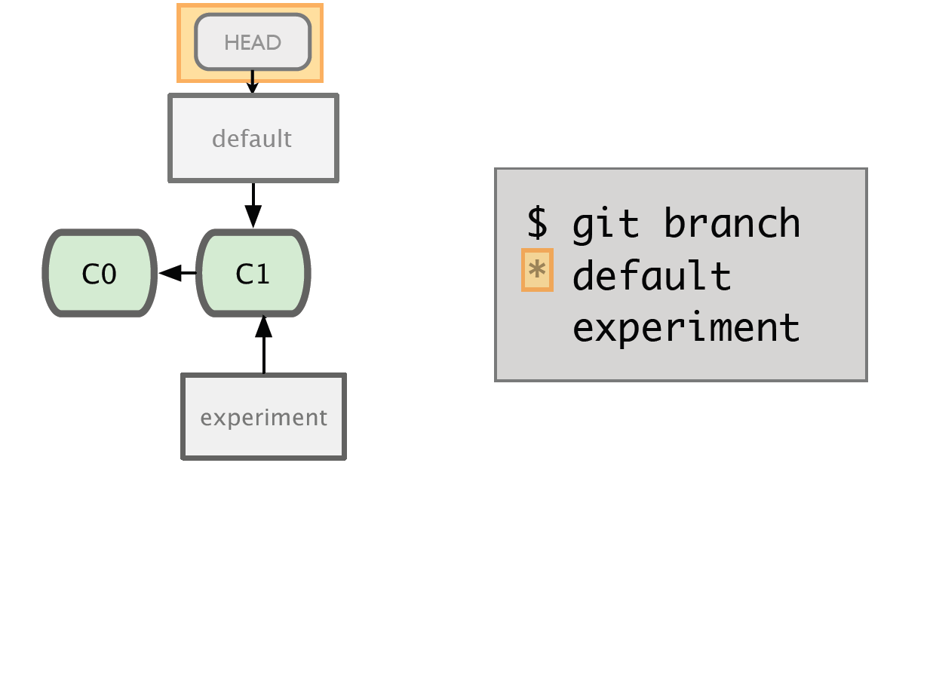
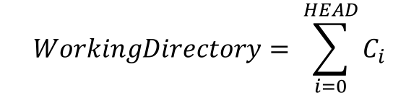
$$WorkingDirectory= \sum_{i=0}^{HEAD}{C_{i}}$$

Slide 21
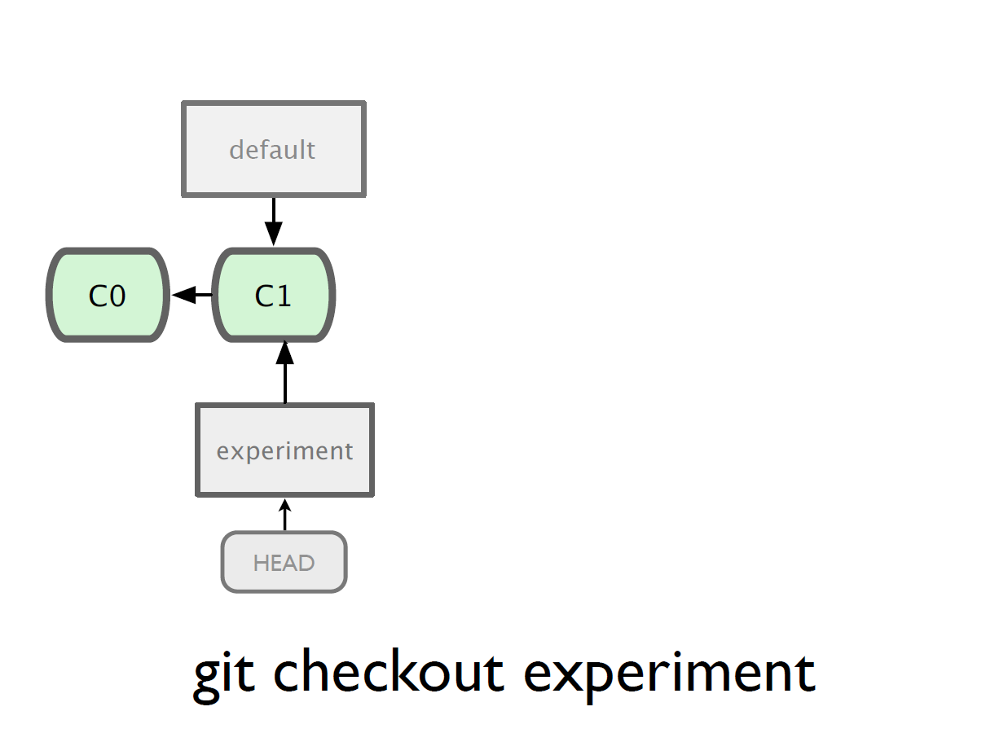
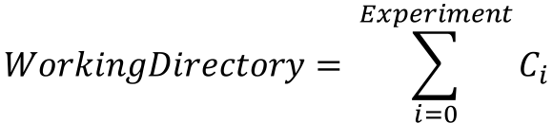
$$WorkingDirectory= \sum_{i=0}^{Experiment}{C_{i}}$$

Slide 22
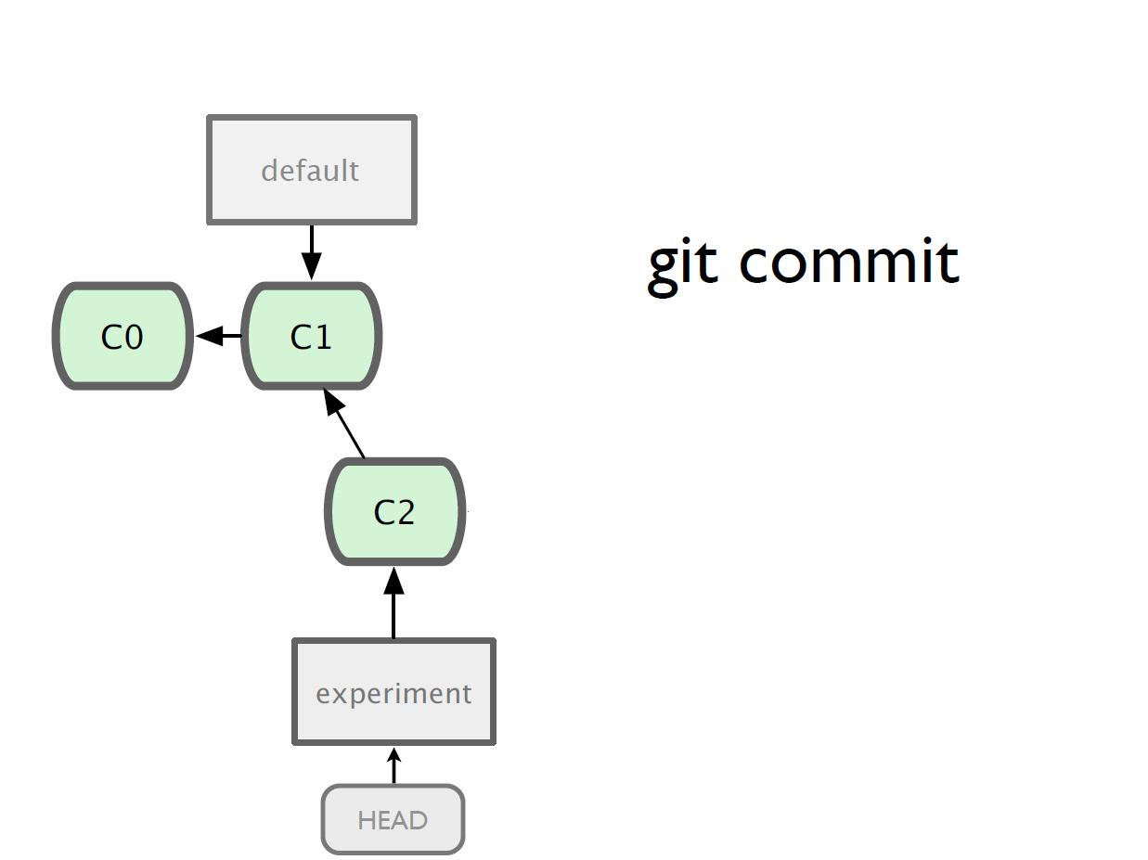
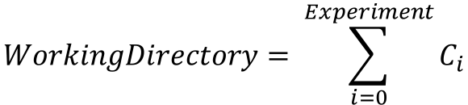
e
$$WorkingDirectory= \sum_{i=0}^{Experiment}{C_{i}}$$

Slide 23
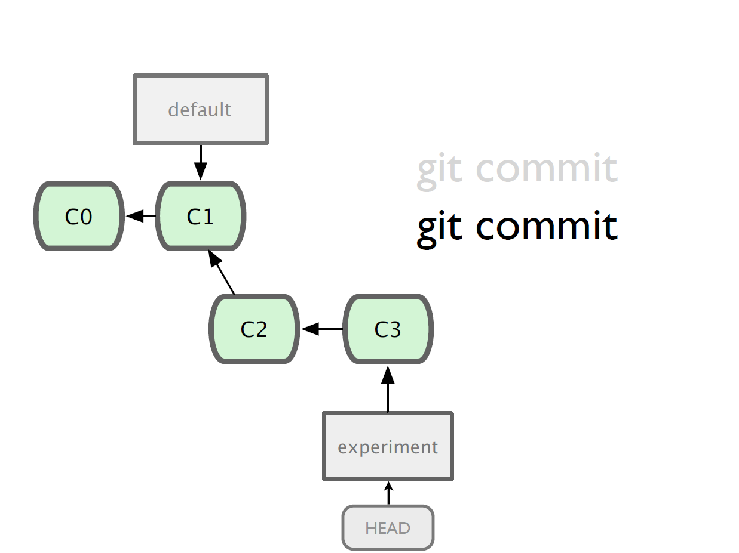

Slide 24
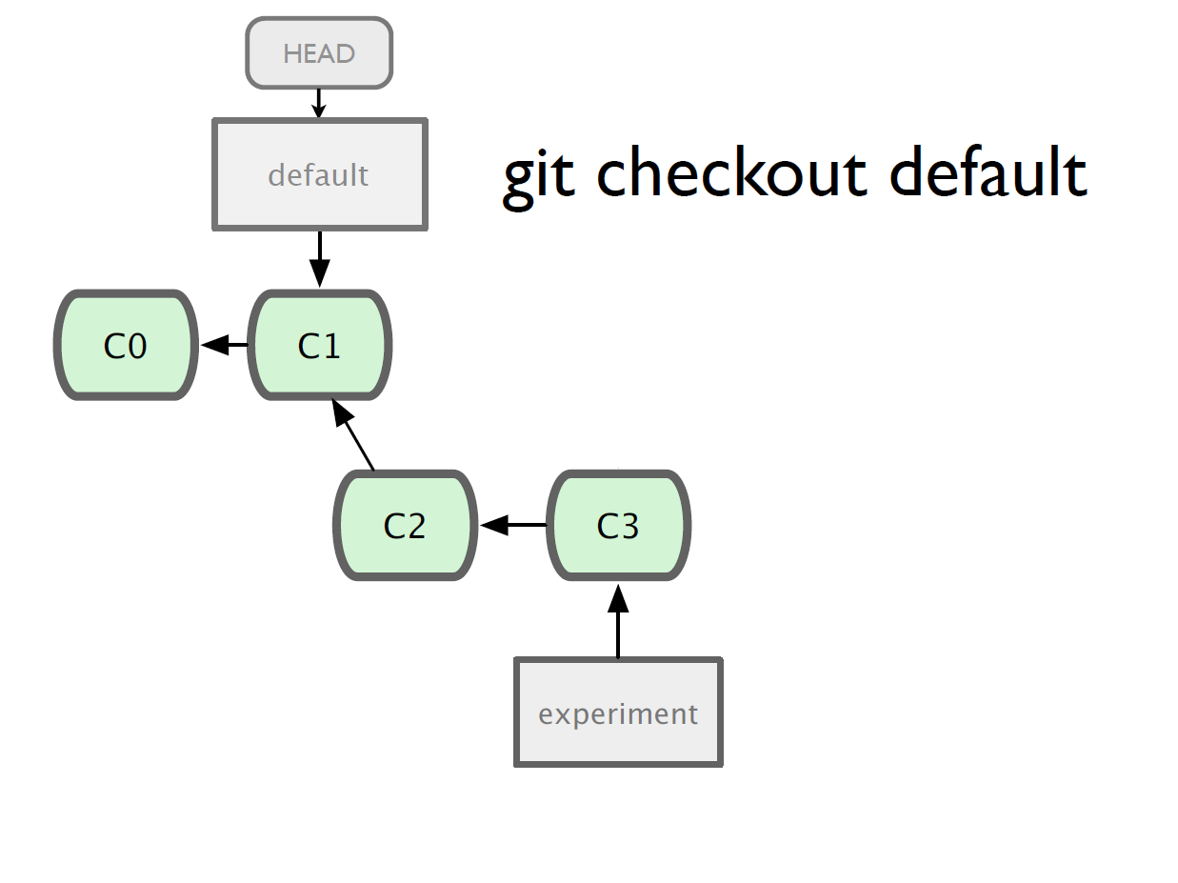

Slide 25
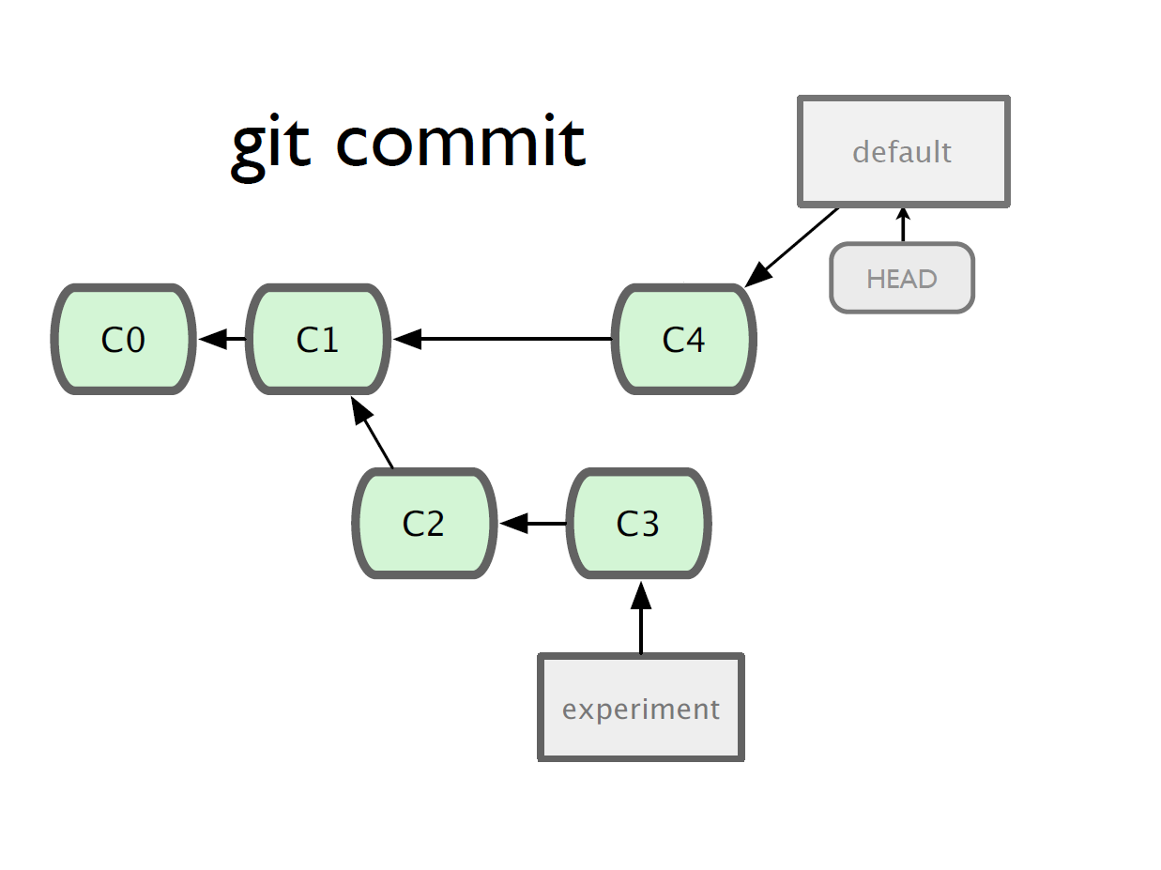

Slide 26
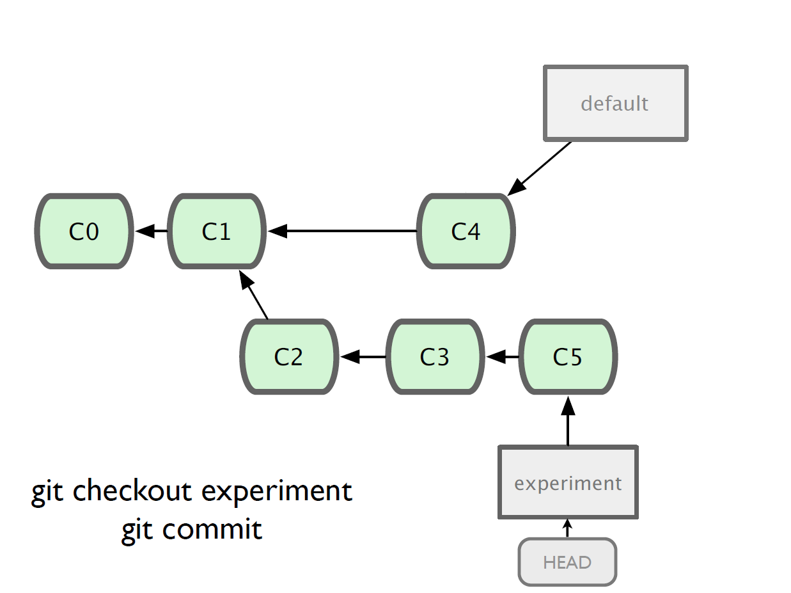

Slide 27
Merging
What do we do with this mess?
Merge them

Slide 28
Merging
Checkout the branch you want to merge onto
Merge the branch you want to merge

Slide 29
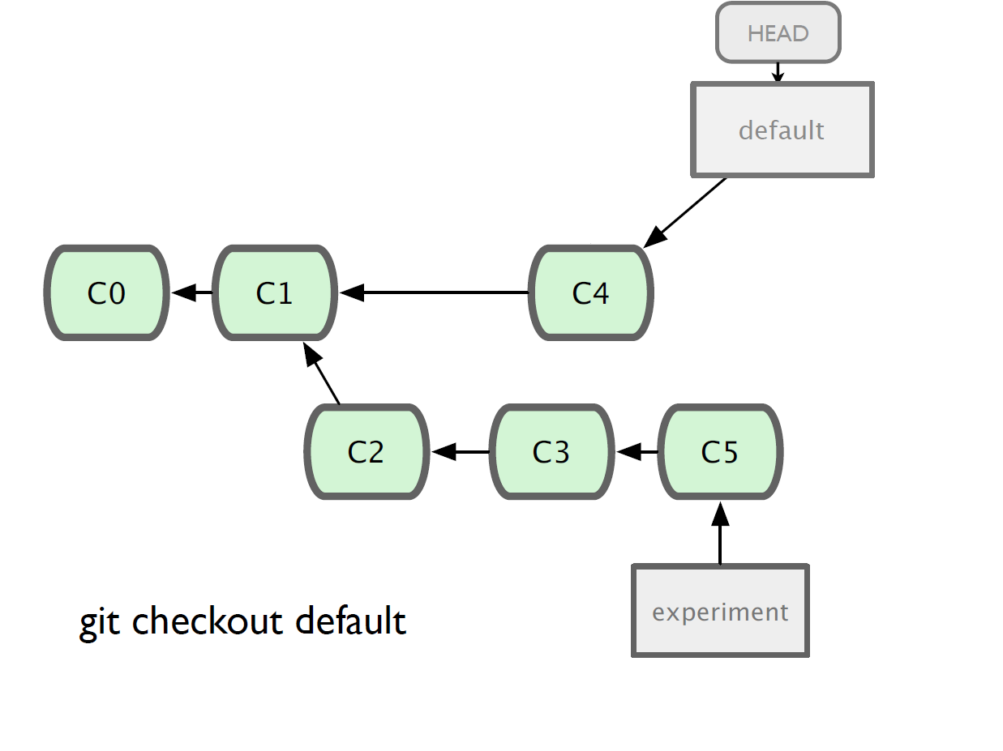

Slide 30
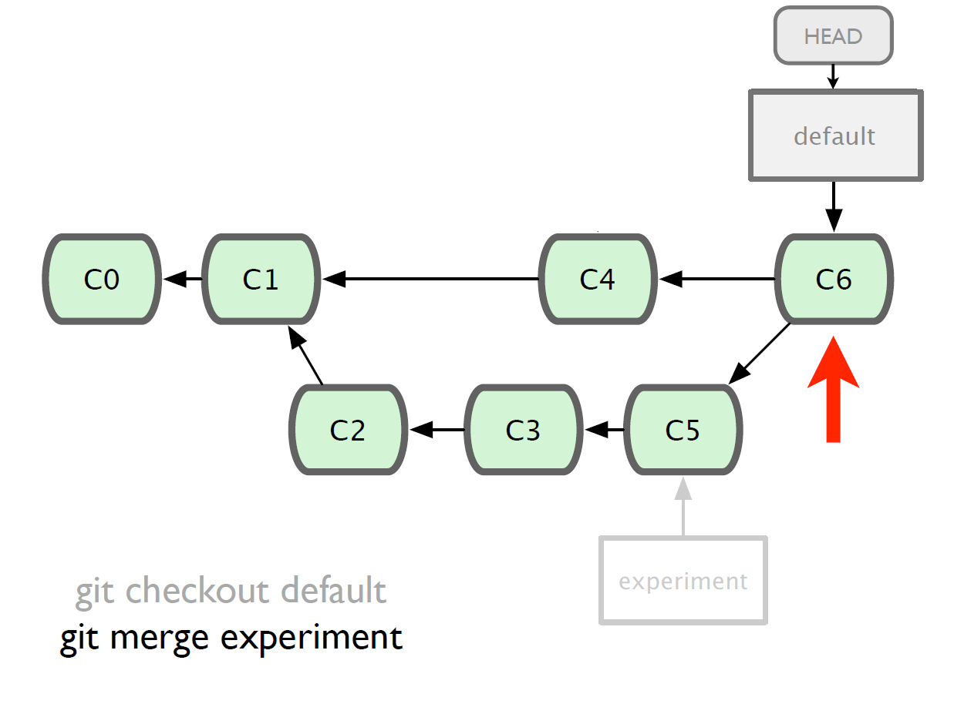
Three-Way Merge (Simplified)
C6 = (C4 – C1) + (C5-C1)

Slide 31
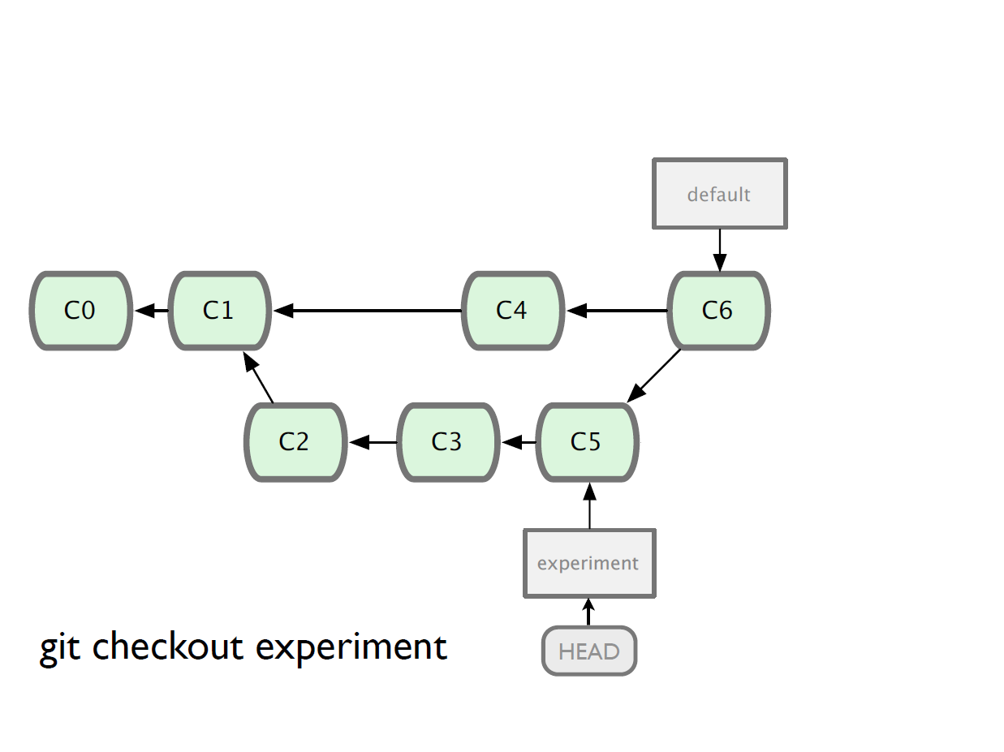

Slide 32
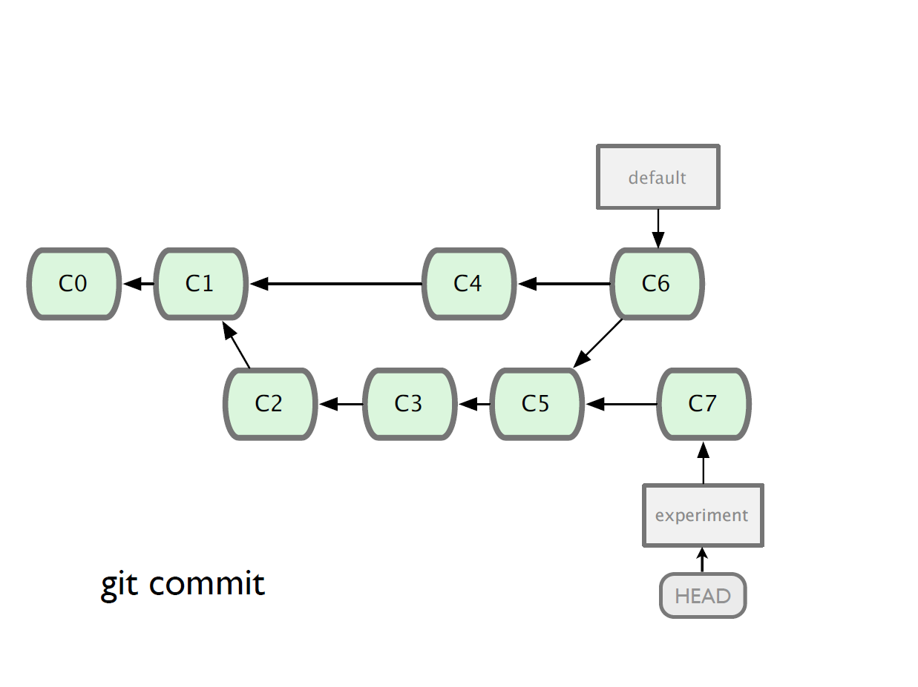

Slide 33
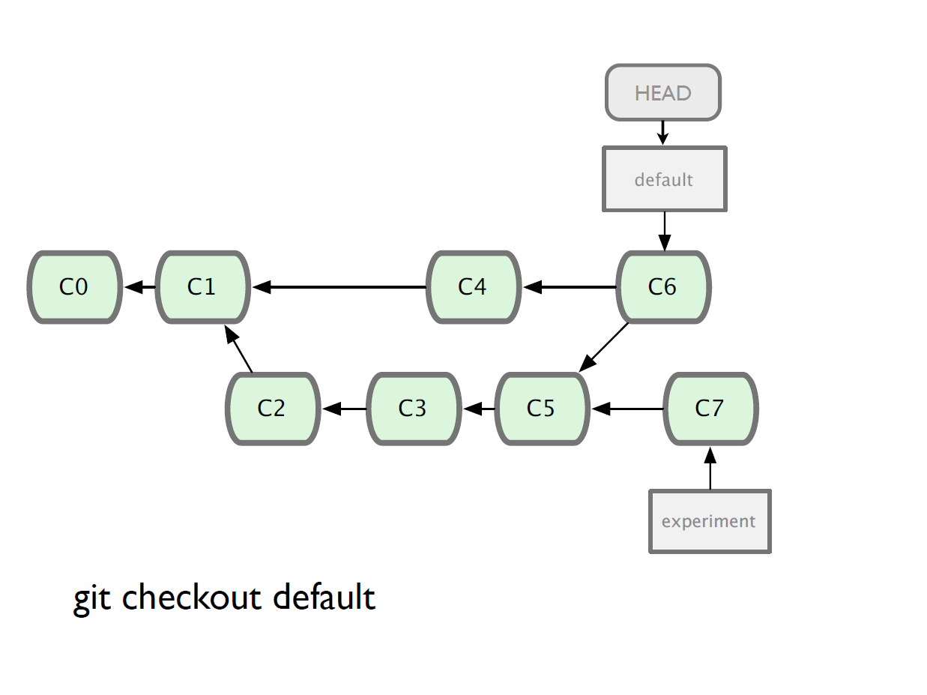

Slide 34
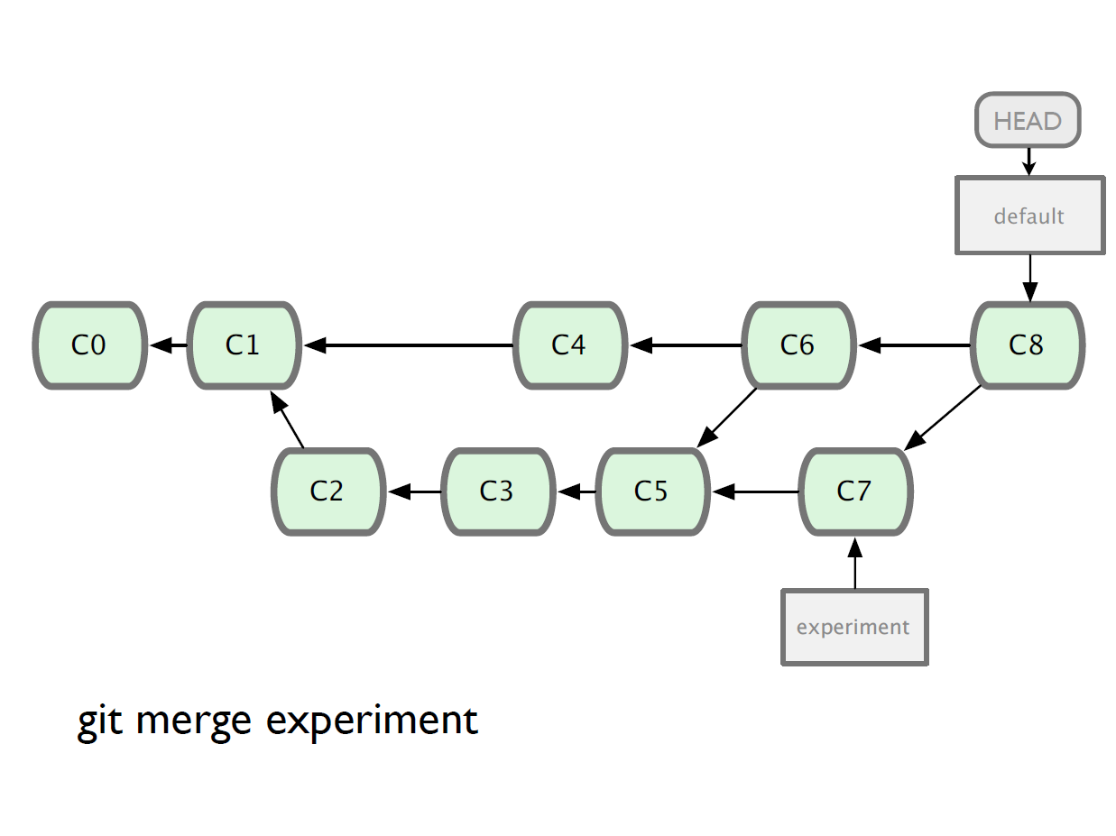

Slide 35
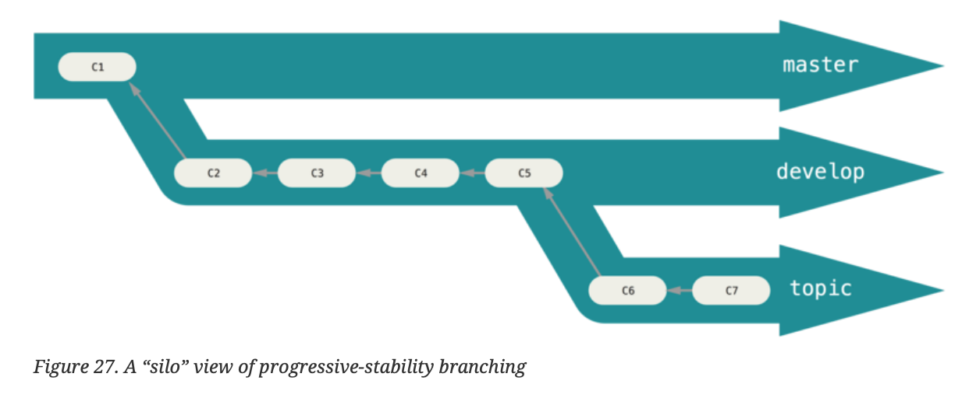
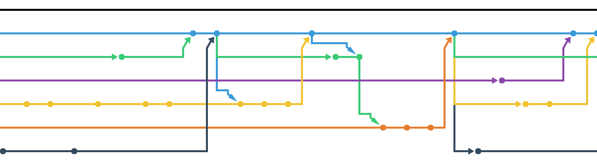
Branching Structure
Pro Git if you want to learn more
https://git-scm.com/book/en/v2

Slide 36
CONFLICT
What do you do when you run into a merge conflict?!?!?
Panic
Cry
Re-clone your repo
All of the above
Lets work through a merge conflict together

Slide 37
Make a repo

Slide 38
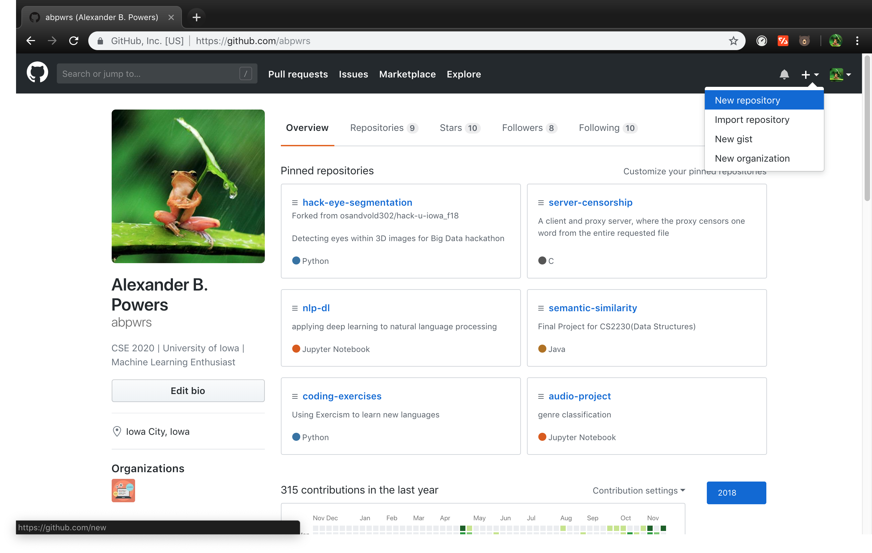

Slide 39
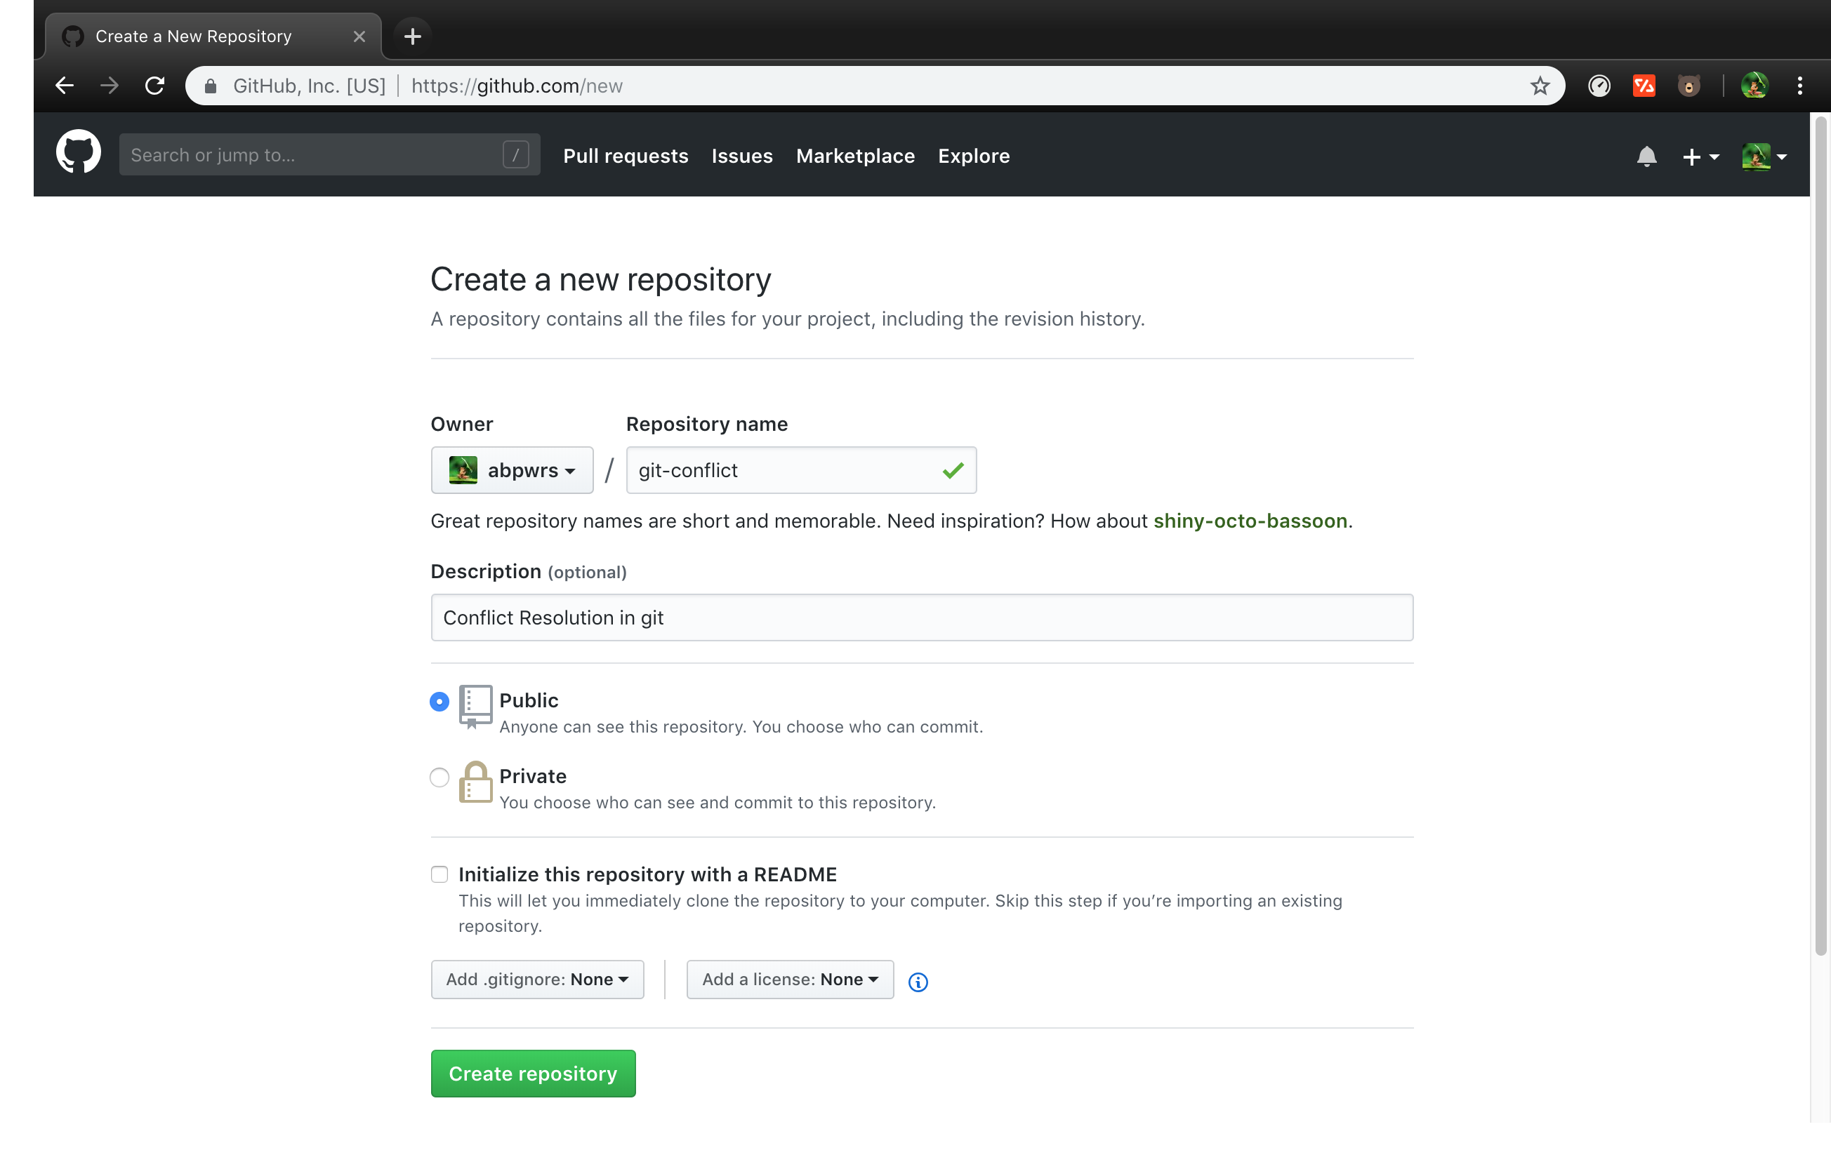

Slide 40
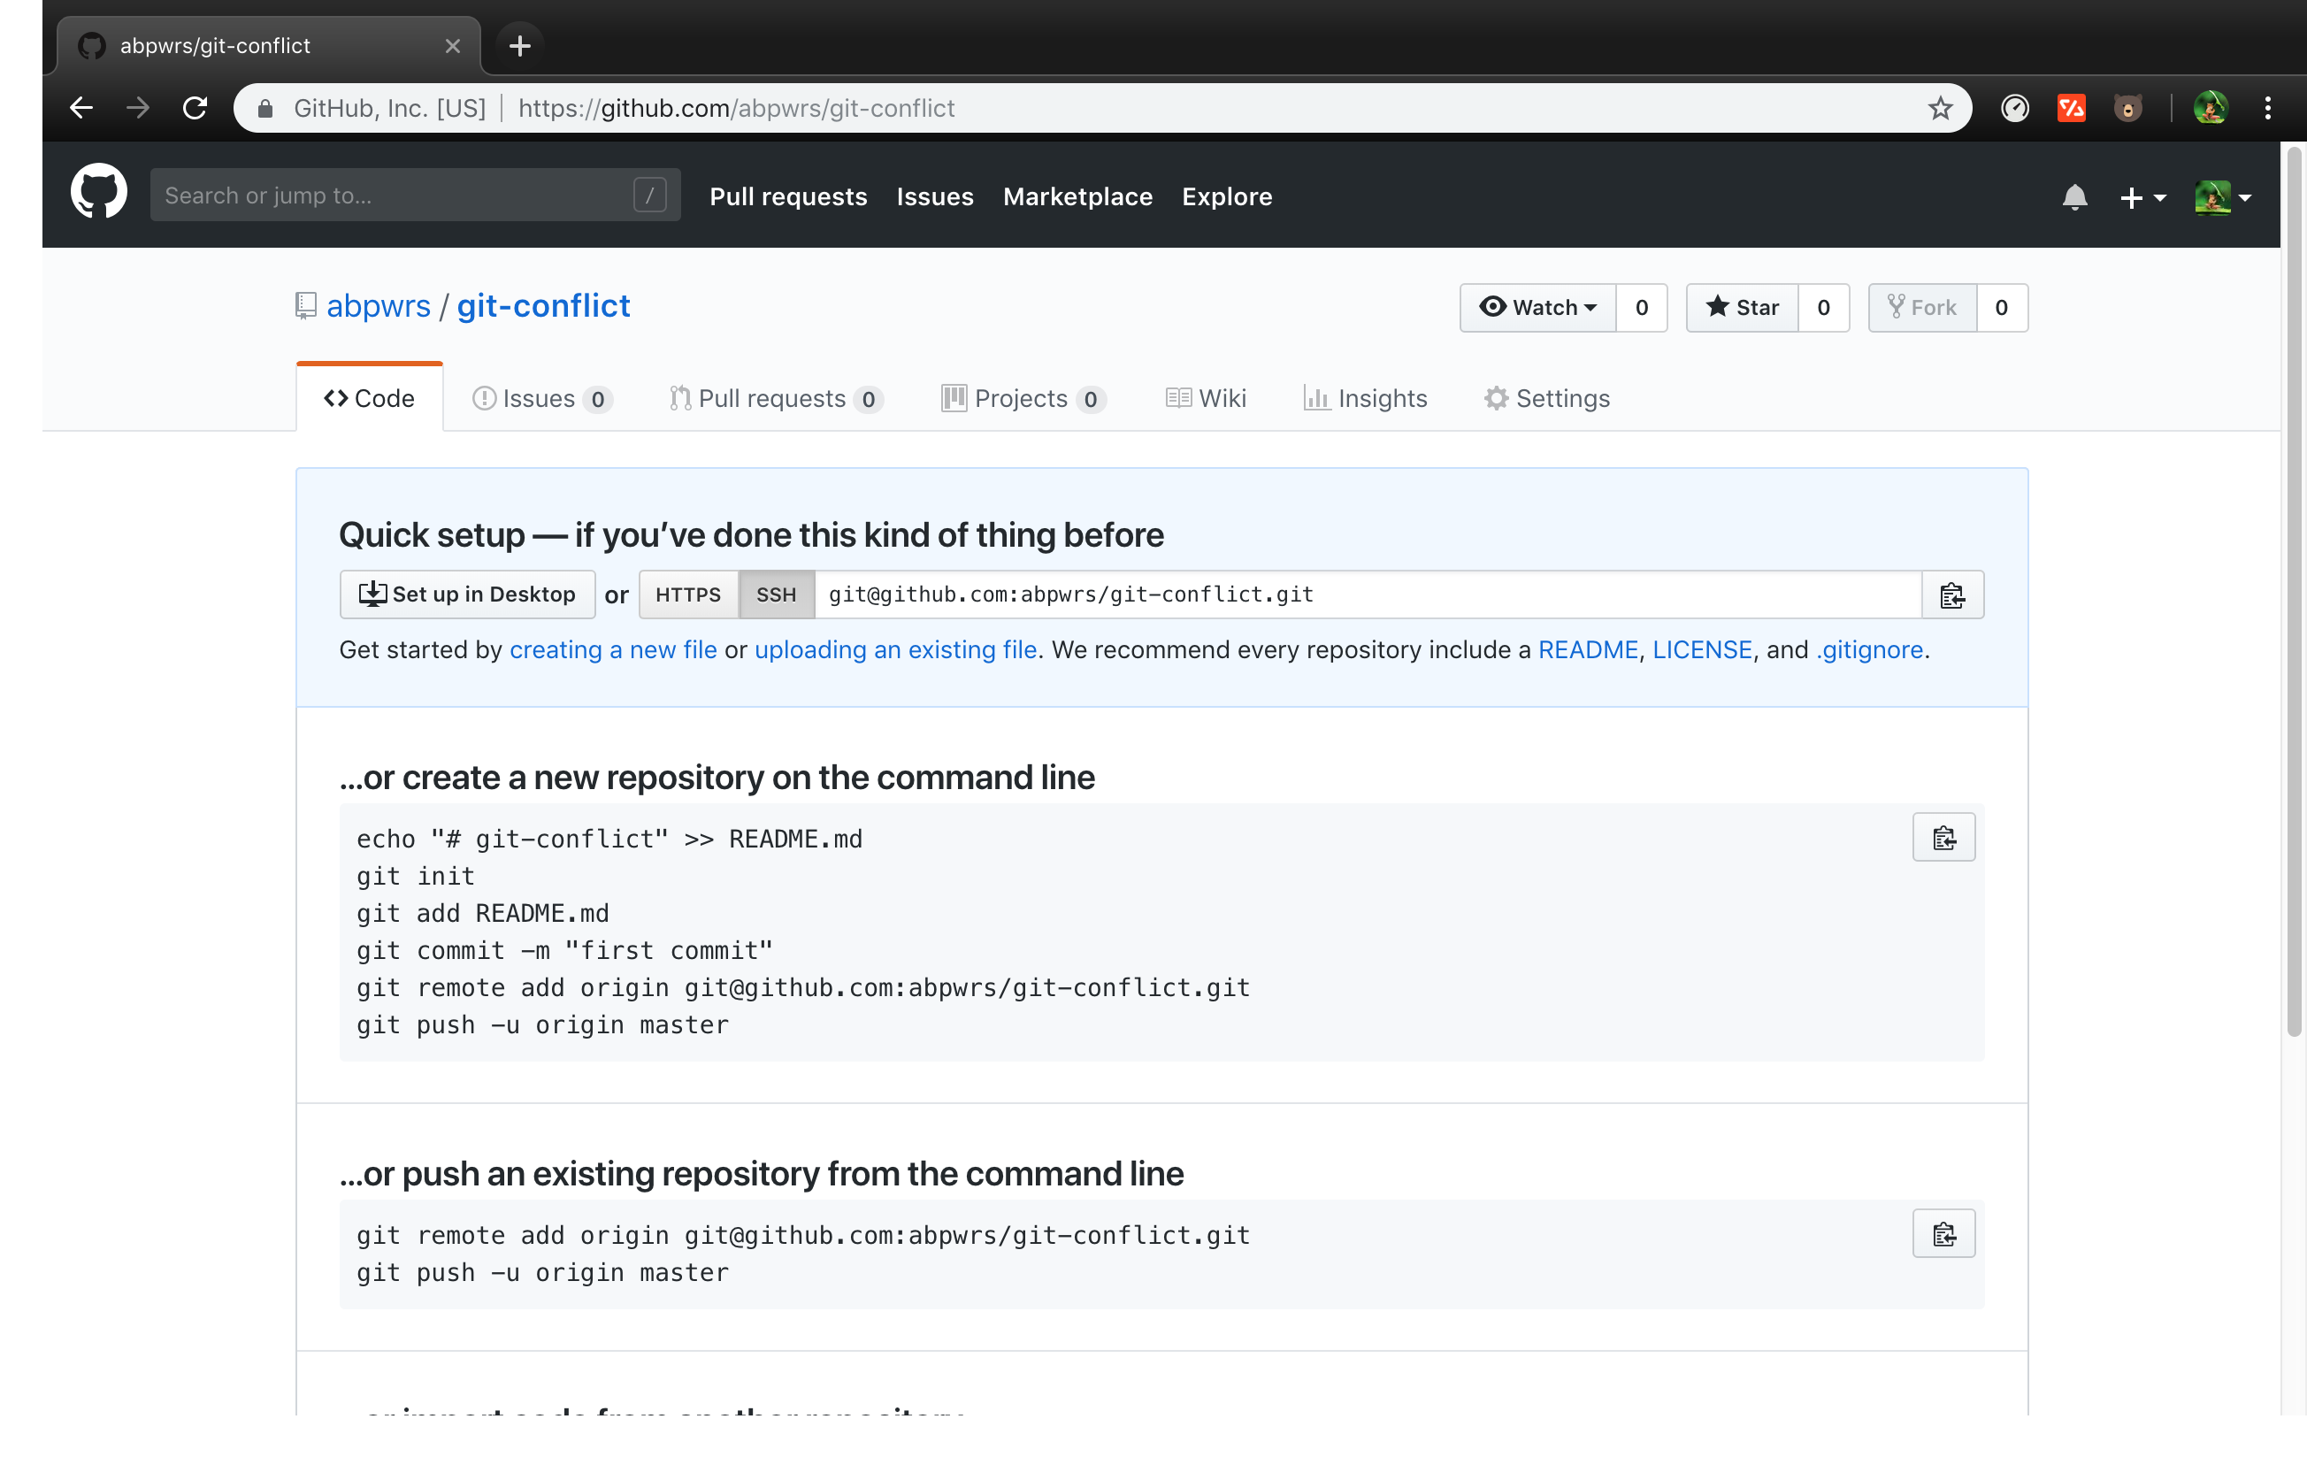

Slide 41
Initialize local repo to use remote we just made
$ mkdir git-conflict
$ cd git-conflict
$ git init
$ echo “git-conflict resolution” >> README.md
$ git add README.md
$ git commit –m “initial commit”
$ git remote add origin git@github.com:USERNAME/git-conflict.git
$ git push –u origin master

Slide 42
Make a Conflict

Slide 43
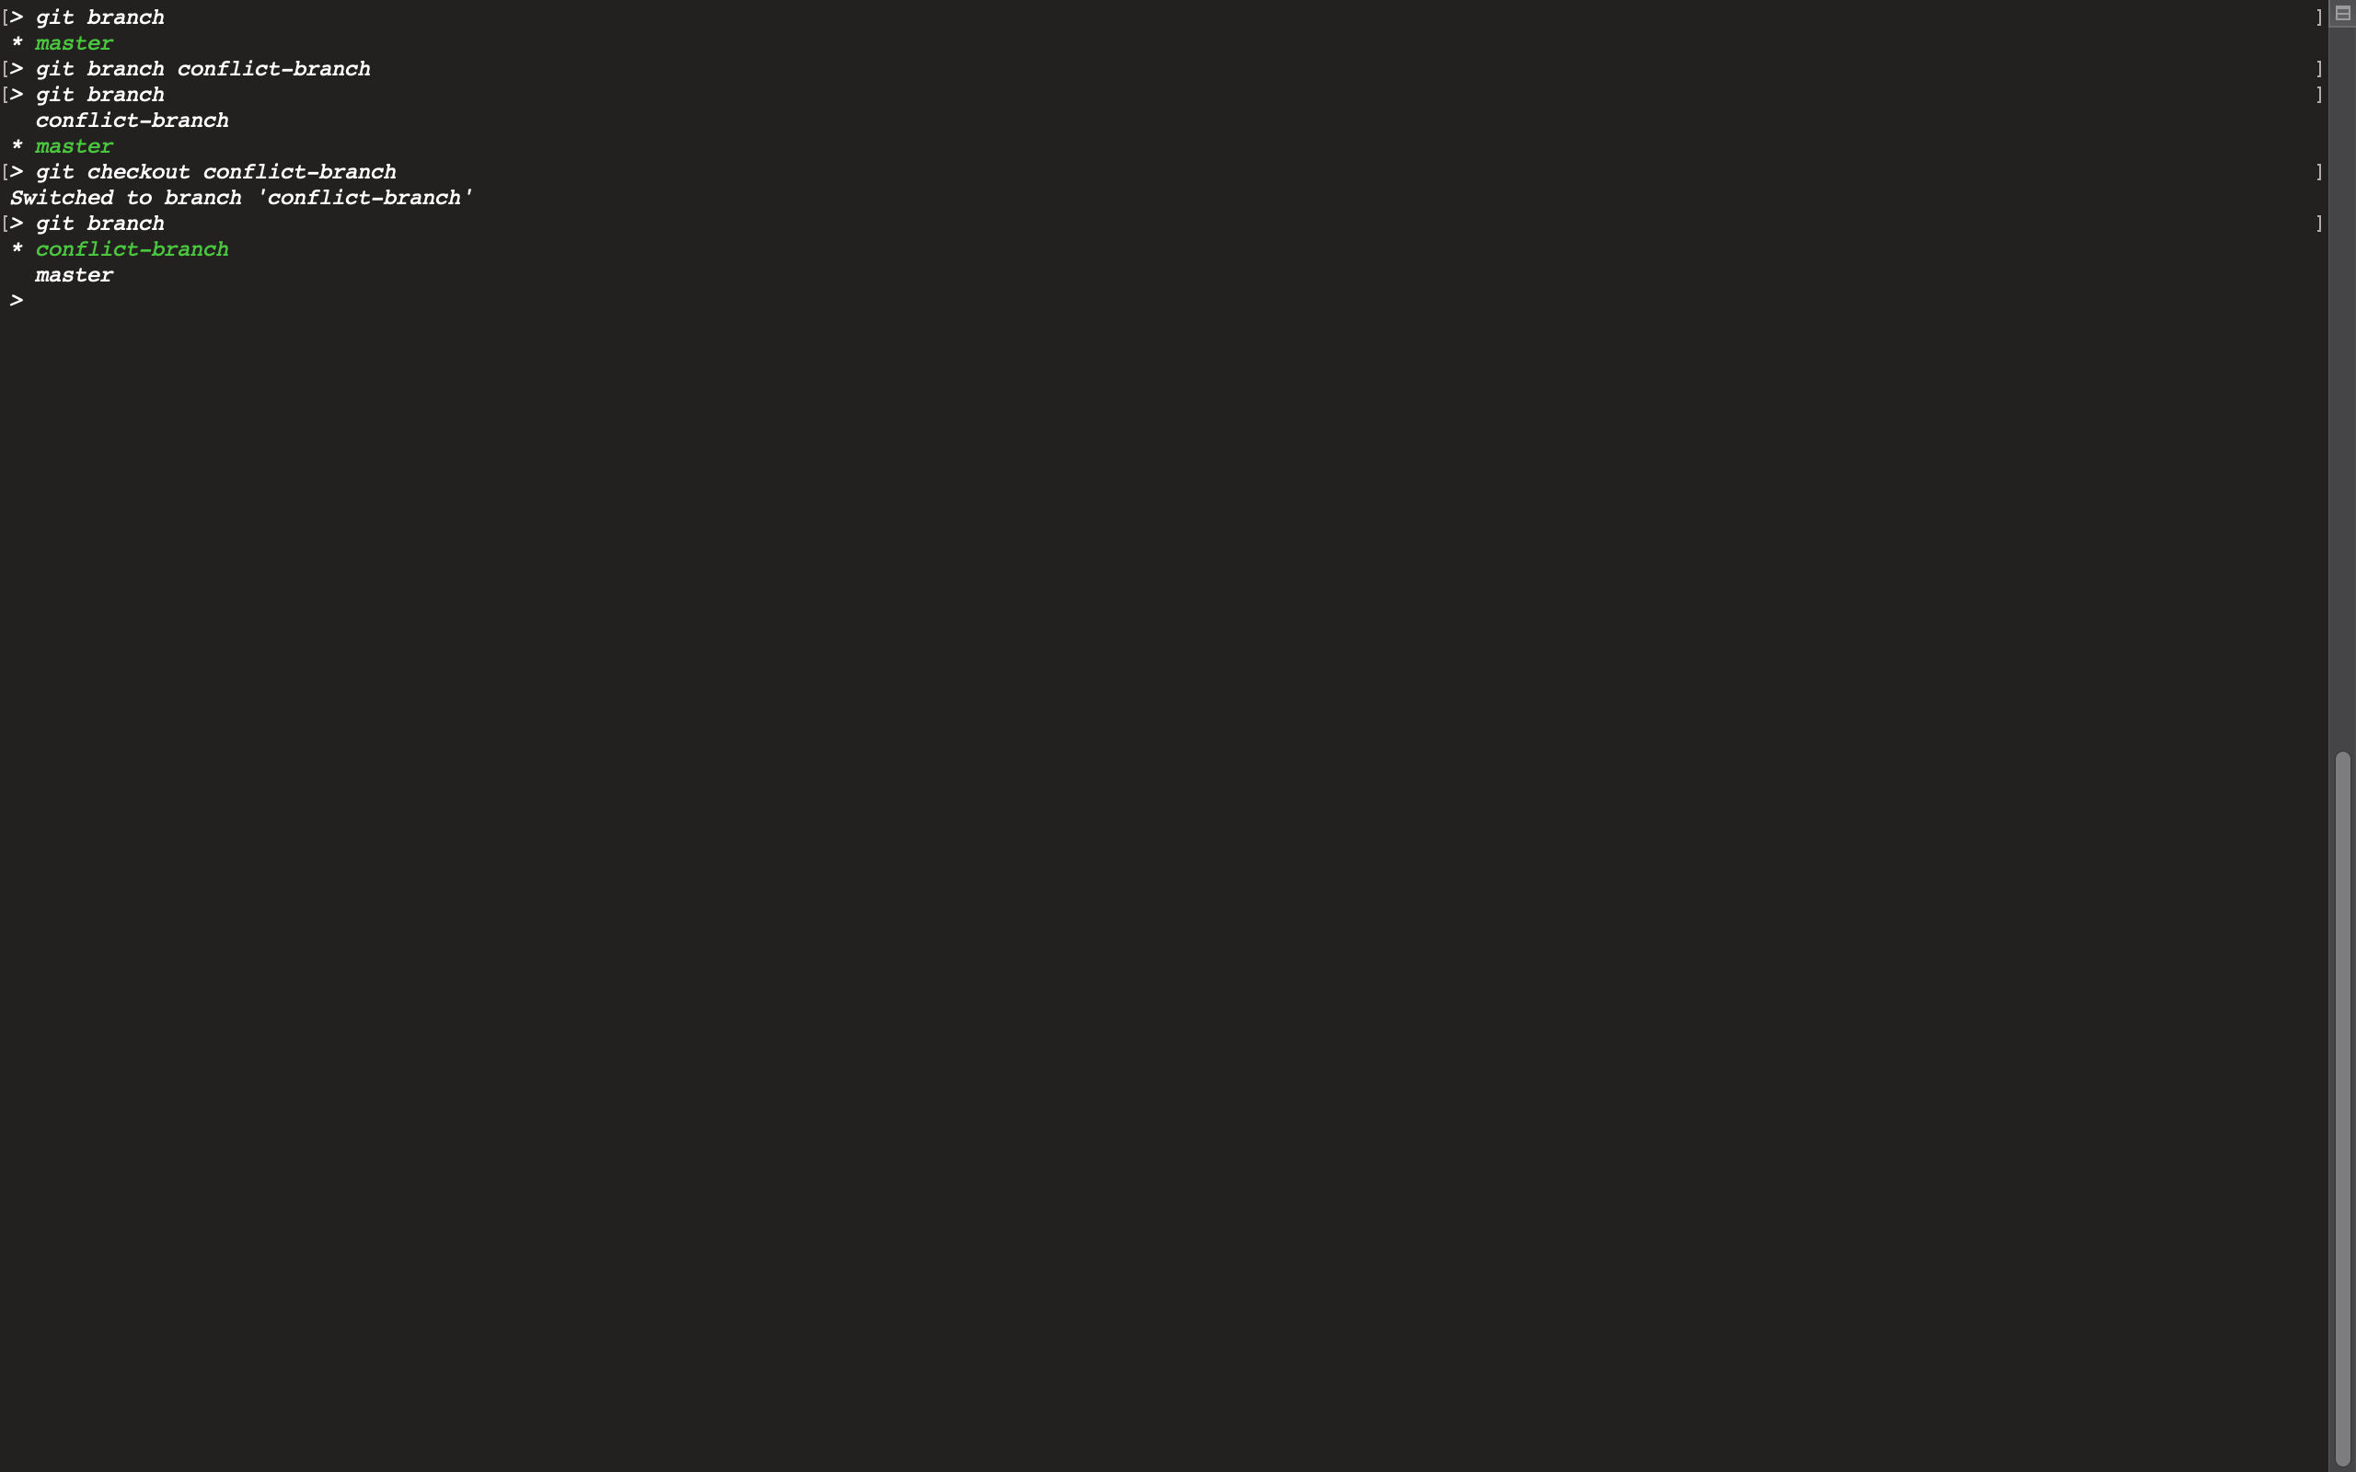

Slide 44
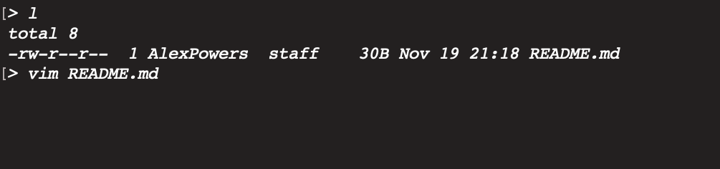

Slide 45
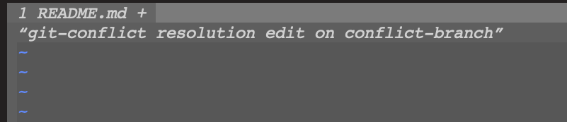

Slide 46
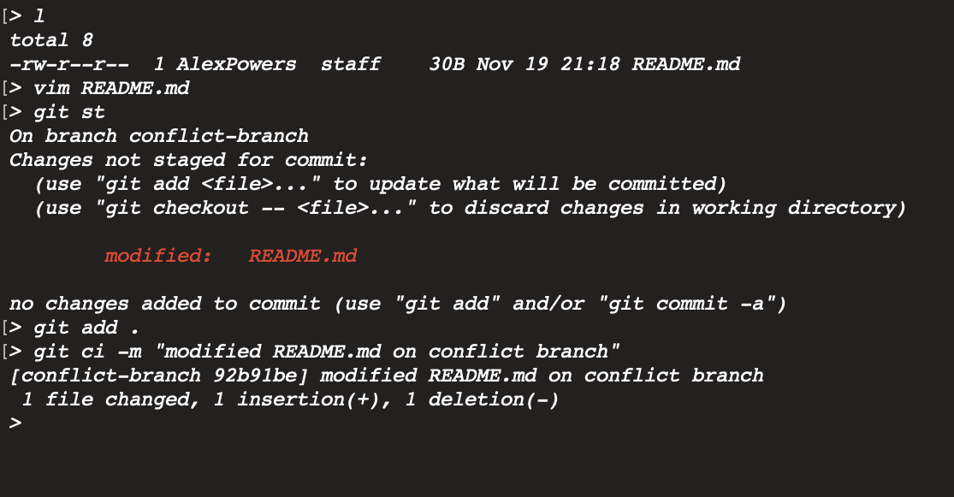

Slide 47
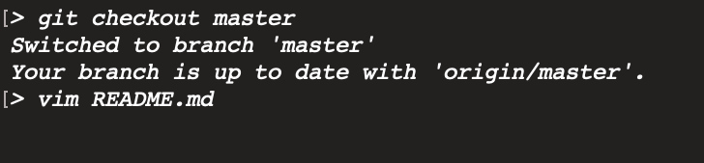

Slide 48
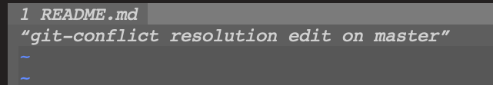

Slide 49
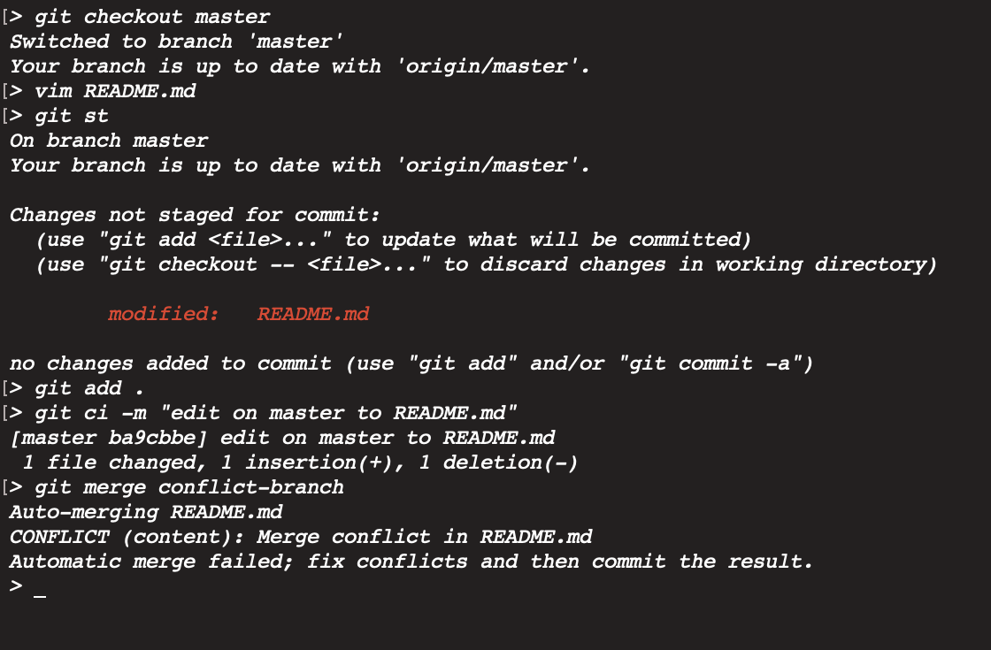

Slide 50
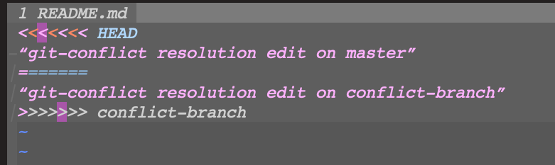

Slide 51
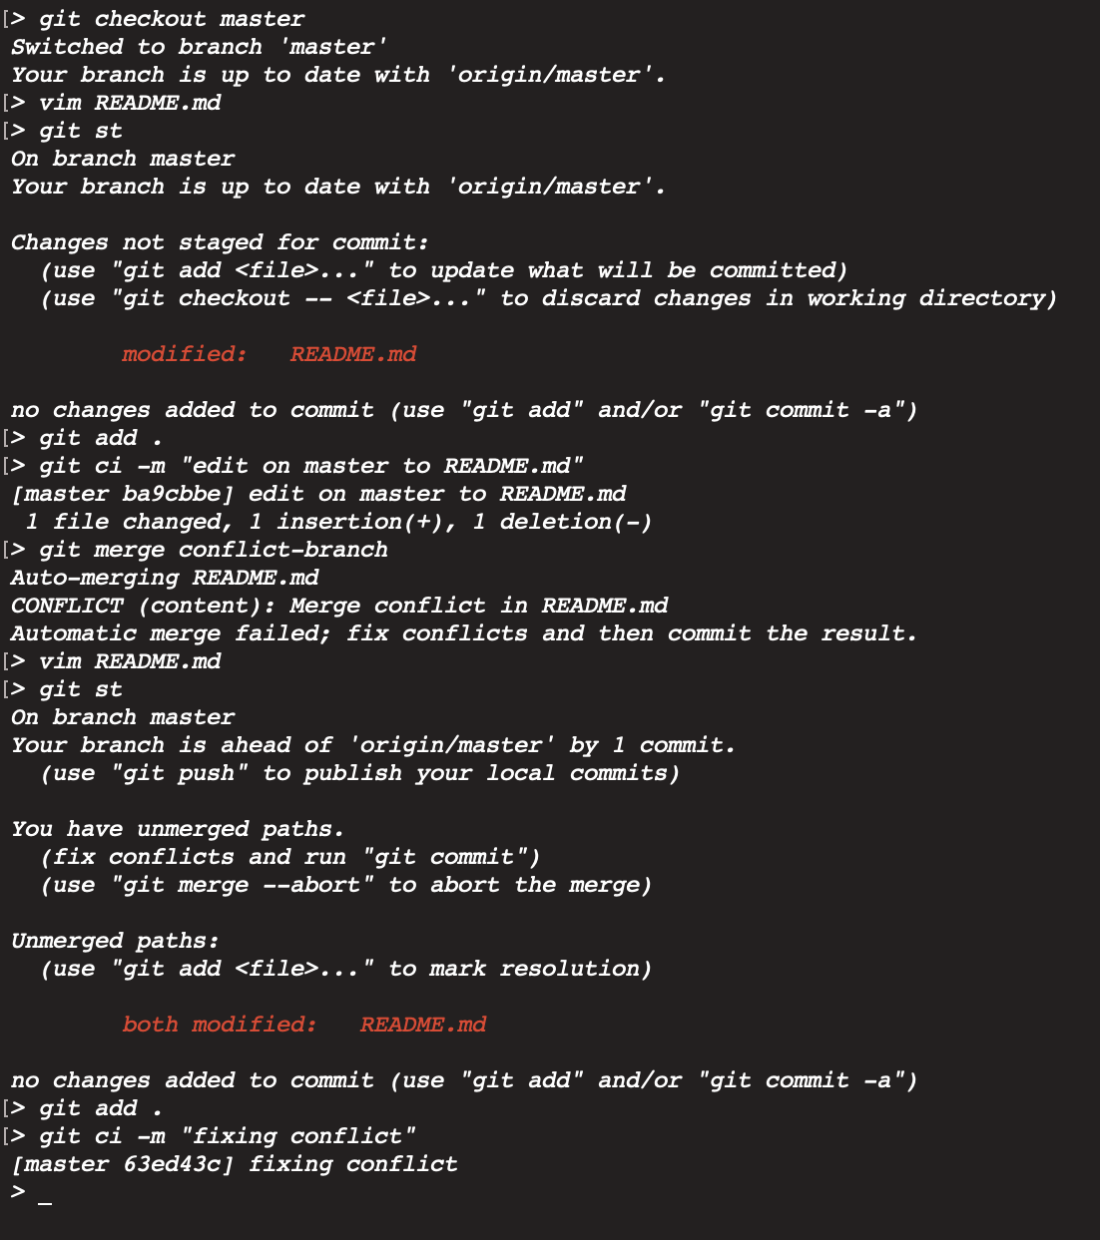

Slide 52
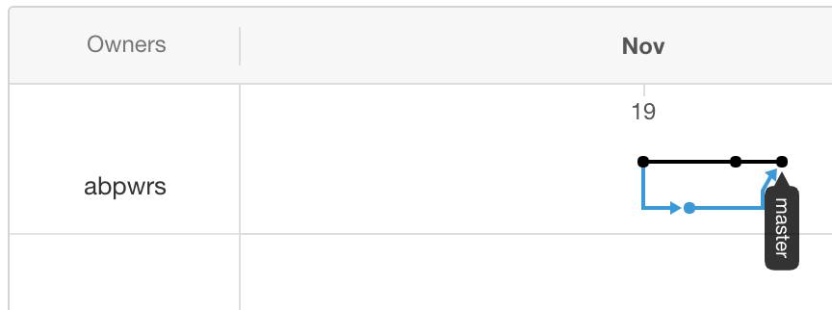
This results in the following

Slide 53
Questions?

Slide 54
Thank You!

